Slide 1





HTTP, AJAX and REST
How HTTP and Web Services Work?
JS Apps
SoftUni Team
Technical Trainers
Software University
http://softuni.bg

Slide 2


Table of Contents
World Wide Web (WWW)
Uniform Resource Locator (URL)
The HTTP Protocol
HTTP Messages
MIME Types
Status Codes
HTML, XML, JSON, RSS
Web Services
AJAX
Same Origin Policy
Web Developer Tools

Slide 3
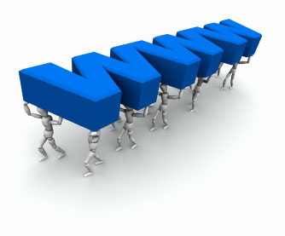

World Wide Web
What is WWW?

Slide 4
What is WWW?
WWW = World Wide Web = Web != Internet
The Internet is a global system of interconnected computer networks
WWW is one of the services transferred over these networks
Global distributed information system in Internet (like E-mail, DNS, ...)
Consists of set of documents (and other resources)
They are located on different Internet servers
Accessed through standard protocols (like HTTP, HTTPS, FTP) by URL
Web servers provide Web content
Web browsers display the Web content

Slide 5
WWW Components
Structural components
Internet – provides data transfer channels over the TCP and HTTP
Clients (Web browsers) – display Web content
Web servers – IIS, Apache, Tomcat, GWS, etc.
Semantic components
Hyper Text Transfer Protocol (HTTP)
Hyper Text Markup Language (HTML)
Uniform Resource Locator (URL)
Uniform Resource Identifiers (URIs)

Slide 6
WWW Infrastructure
The entire WWW system runs over standard networking protocols
TCP, HTTP, FTP, SMTP…
The HTTP protocol is fundamental for WWW
Clients use Web browser to request resources from the Web servers via HTTP
Resources have unique URL address
Servers send the requested resource as a response
Web pages are resources in WWW
HTML text, graphics, animations and other files

Slide 7

URL
Uniform Resource Locator

Slide 8
URL
Uniform Resource Locator (URL)
URL is a formatted string, consisting of:
Protocol for communicating (http, ftp, https...)
Host or IP address (softuni.bg, gmail.com)
Port (default port is 80)
Path can be dynamic or static (/forum, /path/index.php)
Query string (?id=27&lang=en)
Fragment – Only used on the client to navigate to some section
http://yoursite.com:8080/path/index.php?id=27&lang=en#lectures
Scheme
Host
Port
Path
Query
Fragment

Slide 9
URL Encoding
URLs are encoded according RFC 1738:
Safe URL characters – [0-9a-zA-Z] $-_.+*'(),!
All other characters are escaped with the formula:
Space can also be encoded as "+"
%[character hex code in ISO-Latin character set]
ASCII Character | URL encoding
space | %20
! | %21
" | %22
# | %23
$ | %24
% | %25
& | %26

Slide 10
URL – Examples
Some valid URLs:
Some invalid URLs:
http://www.google.bg/search?sourceid=navclient&ie=UTF-8&rlz=1T4GGLL_enBG369BG369&q=http+get+vs+post
http://bg.wikipedia.org/wiki/%D0%A1%D0%BE%D1%84%D1%82%D1%83%D0%B5%D1%80%D0%BD%D0%B0_%D0%B0%D0%BA%D0%B0%D0%B4%D0%B5%D0%BC%D0%B8%D1%8F
Should be: ?q=C%23+.NET+4.0
http://www.google.bg/search?&q=C# .NET 4.0
Should be: ?q=%D0%B1%D0%B8%D1%80%D0%B0
http://www.google.bg/search?&q=бира

Slide 11
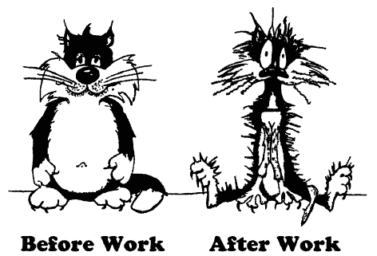


The HTTP Protocol
HTTP
How HTTP Works?

Slide 12
HTTP
HTTP (Hyper Text Transfer Protocol)
Client-server protocol for transferring Web resources (HTML files, images, styles, etc.)
Important properties of HTTP
Request-response model
Text-based format
Relies on unique resource URLs
Provides resource metadata (e.g. encoding)
Stateless (cookies and web storages can overcome this)

Slide 13


HTTP: Request-Response Protocol
Client program
Running on end host
Requests a resource
Server program
Running at the server
Provides resources
HTTP Request
HTTP Response
Web Client
Web Server
A Single HTTP Transaction
13

Slide 14
HTTP Transaction: Example
HTTP Request
HTTP Response
GET /courses/javascript HTTP/1.1
Host: www.softuni.bg
User-Agent: Mozilla/5.0
<CRLF>
The empty line denotes the end of the request header
HTTP/1.1 200 OK
Date: Mon, 5 Jul 2010 13:09:03 GMT
Server: Microsoft-HTTPAPI/2.0
Last-Modified: Mon, 12 Jul 2014 15:33:23 GMT
Content-Length: 54
<CRLF>
<html><title>Hello</title>
Welcome to our site</html>
The empty line denotes the end of the response header

Slide 15
HTTP Request Methods
HTTP defines methods to indicate the desired action to be performed on the identified resource
Method | Description
GET | Retrieve a resource
PUT | Update a resource
POST | Store a resource
DELETE | Remove a resource
HEAD | Retrieve the resource's headers

Slide 16


HTTP Request Message

Slide 17
HTTP Request Message
Request message sent by a client consists of:
Request line
Request method (GET, POST, PUT, DELETE, …)
Resource URI
Protocol version
Request headers – additional parameters
Body – optional data
<request method> <resource> HTTP/<version>
<headers>
<empty line>
<body>

Slide 18
HTTP GET Request – Example
Example of HTTP GET request:
HTTP request line
GET /courses/javascript HTTP/1.1
Host: www.softuni.bg
Accept: */*
Accept-Language: bg
Accept-Encoding: gzip, deflate
User-Agent: Mozilla/4.0(compatible;MSIE 6.0; Windows NT 5.0)
Connection: Keep-Alive
Cache-Control: no-cache
<CRLF>
HTTP headers
The request body is empty

Slide 19
HTTP POST Request – Example
Example of HTTP POST request:
HTTP request line
POST /webmail/login.phtml HTTP/1.1
Host: www.abv.bg
Accept: */*
Accept-Language: bg
Accept-Encoding: gzip, deflate
User-Agent: Mozilla/4.0(compatible;MSIE 6.0; Windows NT 5.0)
Connection: Keep-Alive
Cache-Control: no-cache
Content-Length: 59
<CRLF>
LOGIN_USER=mente
DOMAIN_NAME=abv.bg
LOGIN_PASS=top*secret!
<CRLF>
HTTP headers
The request body contains the submitted data

Slide 20
Conditional HTTP GET – Example
Example of HTTP conditional GET request:
Fetches the resource only if it has been changed at the server
Server replies with "304 Not Modified" if the resource has not been changed
Or "200 OK" with the latest version otherwise
GET /apply HTTP/1.1
Host: www.softuni.bg
User-Agent: Gecko/20100115 Firefox/3.6
If-Modified-Since: Tue, 9 Mar 2015 11:12:23 GMT
<CRLF>

Slide 21

HTTP Response Message

Slide 22
HTTP Response Message
Response message sent by the server consists of:
Status line
Protocol version
Status code
Status phrase
Response headers
Provide meta data
Body
The content of the response
HTTP/<version> <status code> <status text>
<headers>
<CRLF>
<response body – the requested resource>

Slide 23
HTTP Response – Example
Example of HTTP response from the Web server:
HTTP response status line
HTTP/1.1 200 OK
Date: Fri, 17 Jul 2010 16:09:18 GMT+2
Server: Apache/2.2.14 (Linux)
Accept-Ranges: bytes
Content-Length: 84
Content-Type: text/html
<CRLF>
<html>
<head><title>Test</title></head>
<body>Test HTML page.</body>
</html>
HTTP response headers
The HTTP response body

Slide 24
HTTP Response – Example
Example of HTTP response with error result:
HTTP response status line
HTTP/1.1 404 Not Found
Date: Fri, 17 Nov 2014 16:09:18 GMT+2
Server: Apache/2.2.14 (Linux)
Connection: close
Content-Type: text/html
<CRLF>
<HTML><HEAD>
<TITLE>404 Not Found</TITLE>
</HEAD><BODY>
<H1>Not Found</H1>
The requested URL /img/logo.gif was not found on this server.<P>
<HR><ADDRESS>Apache/2.2.14 Server at Port 80</ADDRESS>
</BODY></HTML>
HTTP response headers
The HTTP response body

Slide 25
HTTP Response Codes
HTTP response code classes
1xx: informational (e.g., "100 Continue")
2xx: successful (e.g., "200 OK")
3xx: redirection (e.g., "304 Not Modified", "302 Found")
4xx: client error (e.g., "404 Not Found")
5xx: server error (e.g., "503 Service Unavailable")
"302 Found" redirects the Web browser to another URL

Slide 26
Browser Redirection
HTTP GET requesting a moved URL:
The HTTP response says the browser should request another URL:
GET / HTTP/1.1
Host: http://softuni.org
User-Agent: Gecko/20100115 Firefox/3.6
<CRLF>
HTTP/1.1 301 Moved Permanently
Location: http://softuni.bg
…

Slide 27
Content-Type and Disposition
The Content-Type header at the server specifies how the output should be processed
Examples:
UTF-8 encoded HTML page. Will be shown in the browser.
Content-Type: text/html; charset=utf-8
Content-Type: application/pdf
Content-Disposition: attachment; filename="Report-April-2010.pdf"
This will download a PDF file named Financial-Report-April-2010.pdf

Slide 28
Common MIME Types
Type/Subtype | Description
application/json | JSON data
image/png | PNG image
image/gif | GIF image
text/html | HTML
text/plain | Text
text/xml | XML
video/mp4 | MP4 video

Slide 29

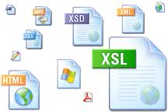

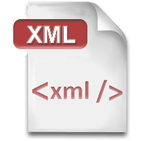


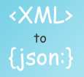

HTML, XML, JSON, RSS
Comparing the Common Web Data Formats

Slide 30
HTML
Hyper Text Markup Language (HTML)
Notation for describing formatted text with images and hyperlinks
Interpreted and displayed by the Web browsers
A Web (HTML) page consists of:
HTML file
CSS stylesheet file (optional)
Images (optional)
Other resources (optional)
HTML is straight-forward and easy to learn
<html>
<head>
<title>HTML Example</title>
<!– styles, scripts -->
</head>
<body>
<h1>Welcome to my blog</h1>
<p>This is my first paragraph</p>
<p>This is my second paragraph</p>
<div>This is a div</div>
</body>
</html>

Slide 31

XML
XML (Extensible Markup Language) is markup-language for encoding documents in machine-readable form
Text-based format
Consists of tags, attributes and content
Provide data and meta-data in the same time
<?xml version="1.0"?>
<library>
<book><title>HTML 5</title><author>Bay Ivan</author></book>
<book><title>WPF 4</title><author>Microsoft</author></book>
<book><title>WCF 4</title><author>Kaka Mara</author></book>
<book><title>UML 2.0</title><author>Bay Ali</author></book>
</library>

Slide 32

RSS
RSS (Really Simple Syndication)
Family of Web feed formats for publishing frequently updated works
E.g. blog entries, news headlines, videos, etc.
Based on XML, with standardized XSD schema
RSS documents (feeds) are list of items
Each containing title, author, publish date, summarized text, and metadata
Atom protocol aimed to enhance / replace RSS

Slide 33
RSS – Example
<?xml version="1.0" encoding="utf-8" ?>
<rss version="2.0">
<channel>
<title>W3Schools Home Page</title>
<link>http://www.w3schools.com</link>
<description>Free web building tutorials</description>
<item>
<title>RSS Tutorial</title>
<link>http://www.w3schools.com/rss</link>
<description>New RSS tutorial on W3Schools</description>
</item>
<item>
<title>XML Tutorial</title>
<link>http://www.w3schools.com/xml</link>
<description>New XML tutorial on W3Schools</description>
</item>
</channel>
</rss>

Slide 34
JSON
JSON (JavaScript Object Notation)
Standard for representing data structures and associative arrays
Lightweight text-based open standard
Derived from the JavaScript language
{
"firstName": "John", "lastName": "Smith", "age": 25,
"address": { "streetAddress": "Vasil Kynchev 26",
"city": "Sofia", "postalCode": "2400" },
"phoneNumber": [{ "type": "home", "number": "212 555-1234"},
{ "type": "fax", "number": "646 555-4567" }]
},
{ "firstName": "Bay", "lastName": "Ivan", "age": 79 }

Slide 35
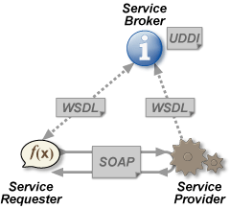
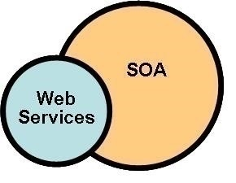
Web Services
Web Services and SOA Architecture

Slide 36
Web Services
A web service is a method of communication between two devices in WWW
The server device exposes services
The client consumes these services
Web services are a main part of the SOA architecture
Database and business logic on the server (backend)
The server exposes public services
UI logic on the client
Consumes these services

Slide 37
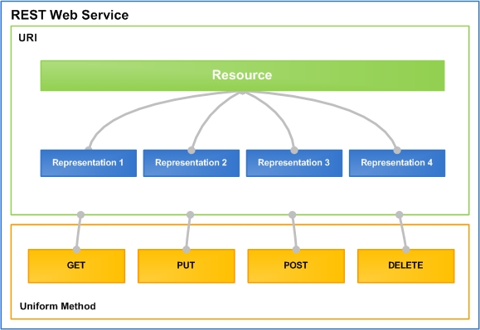
RESTful Web Services
Lightweight Architecture for Web Services

Slide 38
What is REST?
"Representational state transfer (REST) is a style of software architecture for distributed hypermedia systems such as the World Wide Web."
Application state and functionality are resources
Resources are used as common data files
Every resource has an URI
All resources share a uniform interface
This natively maps to the HTTP protocol

Slide 39
RESTful Services
One URI for a resource, multiple operations
Add a new document "RestTalk" in category "Code"
POST http://mysite.com/docs/Code/RestTalk
Get the document / some page
GET http://mysite.com/docs/Code/RestTalk
GET http://mysite.com/docs/Code/RestTalk/pages/3
Remove the document
DELETE http://mysite.com/docs/Code/RestTalk
Retrieve metadata
HEAD http://mysite.com/docs/Code/RestTalk

Slide 40



AJAX
Asynchronous JavaScript and XML

Slide 41
AJAX
AJAX is acronym of Asynchronous JavaScript and XML
Technique for background loading of dynamic content and data from the server side
Allows dynamic client-side changes
Two types of AJAX
Partial page rendering – loading of HTML fragment and showing it in a <div> (AHAH)
JSON service – loading JSON object and client-side processing it with JavaScript / jQuery

Slide 42

AJAX Diagram
1. HTTP Request
2. HTTP Response (HTML Page)
AJAX Request
UI Interaction
AJAX Response + call handler
AJAX handler
Returns data as JSON, HTML
Web Client
Web Server
DOM Manupulation

Slide 43
AJAX
Technically, AJAX is a group of technologies working together
HTML & CSS for presentation
The DOM for data display & interaction
XML (or JSON) for data interchange
XMLHttpRequest for async communication
JavaScript to use the above

Slide 44
AJAX (2)
AJAX uses HTTP
Requests have headers – GET, POST, HEAD, etc.
Requests have bodies – XML, JSON or plain text
The request must target a resource with a URI
The resource must understand the request
Server-side logic
Requests get a HTTP Response
Header with a body

Slide 45

The Same Origin Policy
i.e. Don't Talk to Strangers

Slide 46
Same Origin Policy
Same Origin Policy is
Security restriction for browser-side programming languages
Scripts running on a page
Can access all pages from the same site (same origin)
Cannot access pages on different sites (different origin)
This also applies to XMLHttpRequest (AJAX calls)
Sent only between pages within the same origin

Slide 47
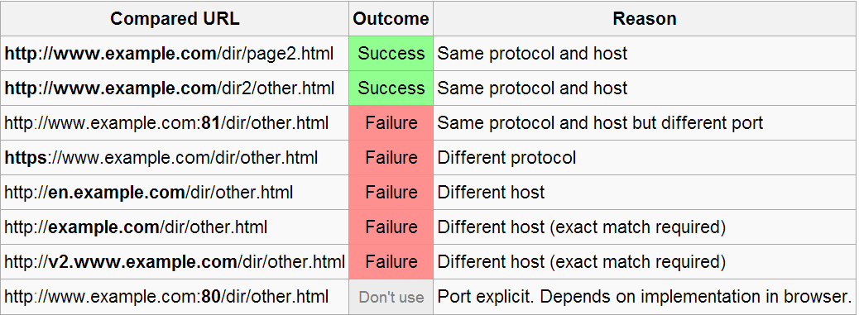
Origin Determination Rules
Origin is defined using:
Application layer protocol (e.g. http)
Domain name (e.g. example.com)
Port number (e.g. example.com:8080)
Two resources are of the same origin if all of the above match

Slide 48
Relaxing the Same Origin Policy
The "Same Origin Policy" is sometimes too restrictive
Large sites with lots of subdomains
Accessing web services
Ways of "relaxing"
Cross-Origin Resource Sharing (CORS)
A site explicitly allows "HTTP calls from everywhere"
document.domain
Can be set to a super domain when in proper subdomain
Cross document messaging
Allowing documents to communicate across different origins
Workaround: JSONP (uses <script> to skip the same origin policy)

Slide 49
Cross-Origin Resource Sharing (CORS)
CORS allows a site to declare its cross-domain origin policy
"Accessible from everywhere" / "accessible from certain origins"
CORS: how it works?
The browser sends one-time HTTP OPTIONS request to ask the server for cross-domain access permissions
The server accepts / denies the request
OPTIONS /some-service/ HTTP/1.1
Host: server-site.com
Origin: http://slient-site.com
HTTP/1.1 200 OK
Access-Control-Allow-Origin: *
…

Slide 50


Web Developer Tools
Simulating and Tracking Web Traffic

Slide 51


Web Developer Tools
Fiddler – HTTP proxy
Intercepts the HTTP traffic
Analyzes the HTTP conversation
Free tool (by Telerik) – http://www.telerik.com/fiddler
Firebug plug-in for Firefox
A must have for Web developers
The ultimate tool for monitoring, editing and debugging HTTP, HTML, CSS, JavaScript, etc.
Free, open-source – www.getfirebug.com

Slide 52
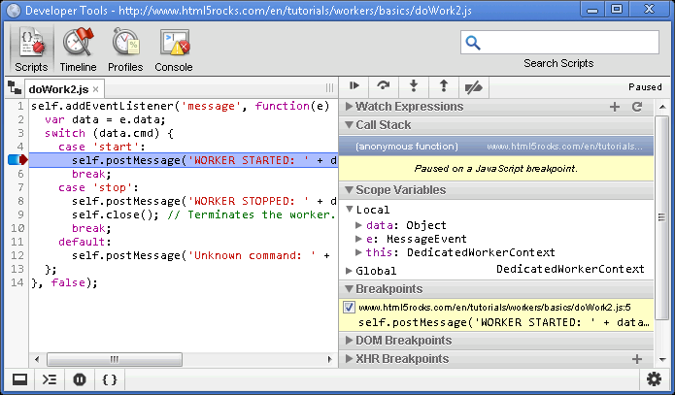
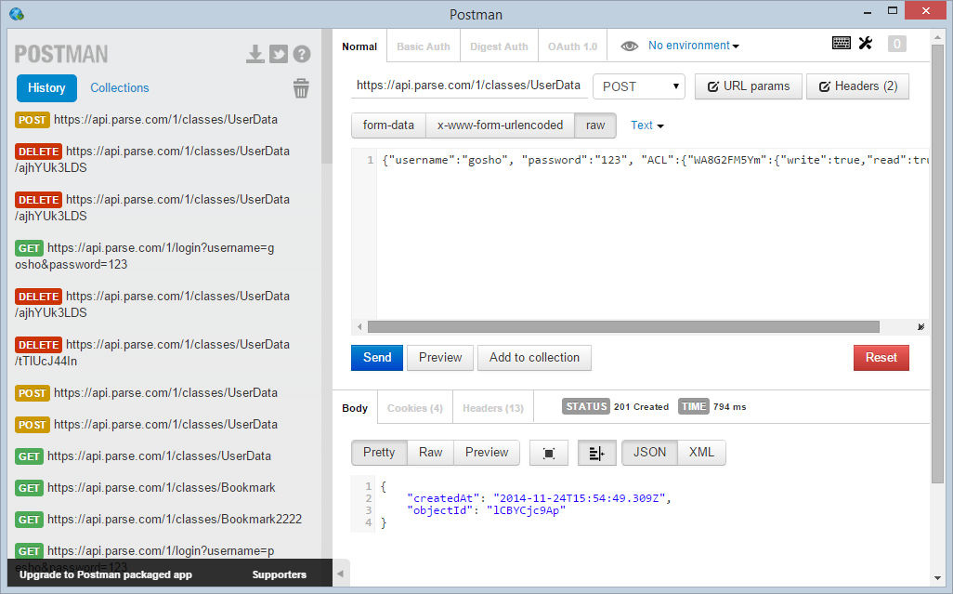
Web Developer Tools (2)
Web Developer Tools
Built-in in Google Chrome and Opera
Network requests logging
Code execution timeline
Postman
Google app
Perform HTTP requests
Get from Chrome Web Store

Slide 53

Summary
What is the difference between WWW & Internet?
What is query string?
What is HTTP? How is done the communication?
What does HTTP request and response contain?
What is RSS used for? What is the format of XML?
What is REST?
What does AJAX give us?
What is the Same Origin Policy?
What is CORS?

